Slide 1
Semester Project Weekly Meeting – 22-11-2022
Nicolas Y.C. Triebold

Slide 2
Last Week
Mid-term presentation
Concept FoV restriction device
Implement CLA room layout in unity
Using HTC VIVE HMD with unity room layout
Tracking Location and Orientation of HTC VIVE Pro:
How to use quaternions to calculate roll, pitch and yaw
How to calculate angular rotation and velocity: Implemented in an excel file

Slide 3
Current Challenges
Mid-term presentation
Test Location:
Coffee Corner or CLA A floor?
Considerations:
Room Size
Wall height
Test Card Design:
A4 with Letter-Number and border
A3 with Letter-Number and border
# of Focus Cards

Slide 4
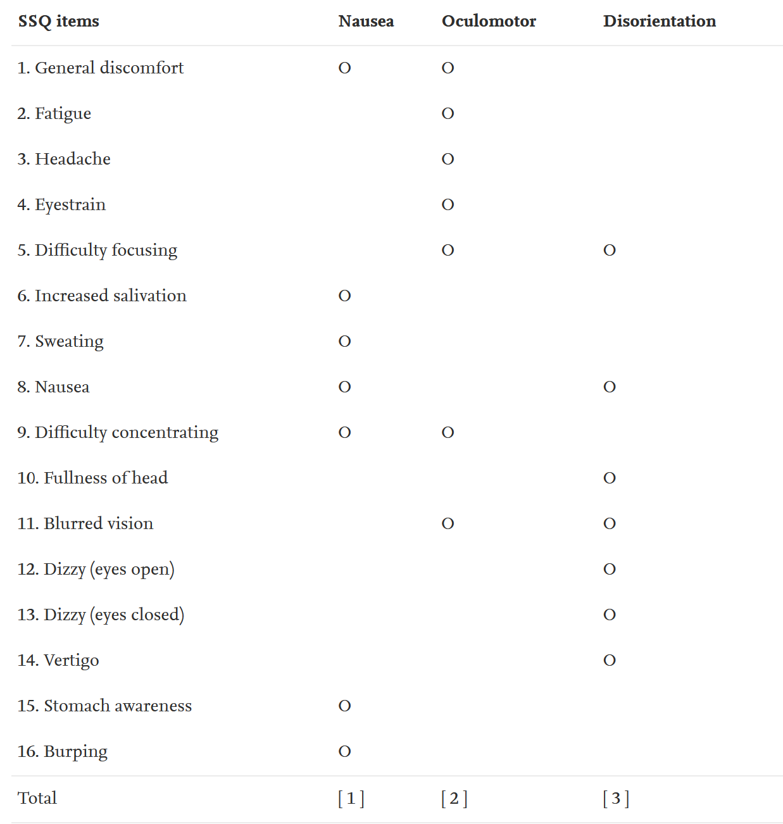
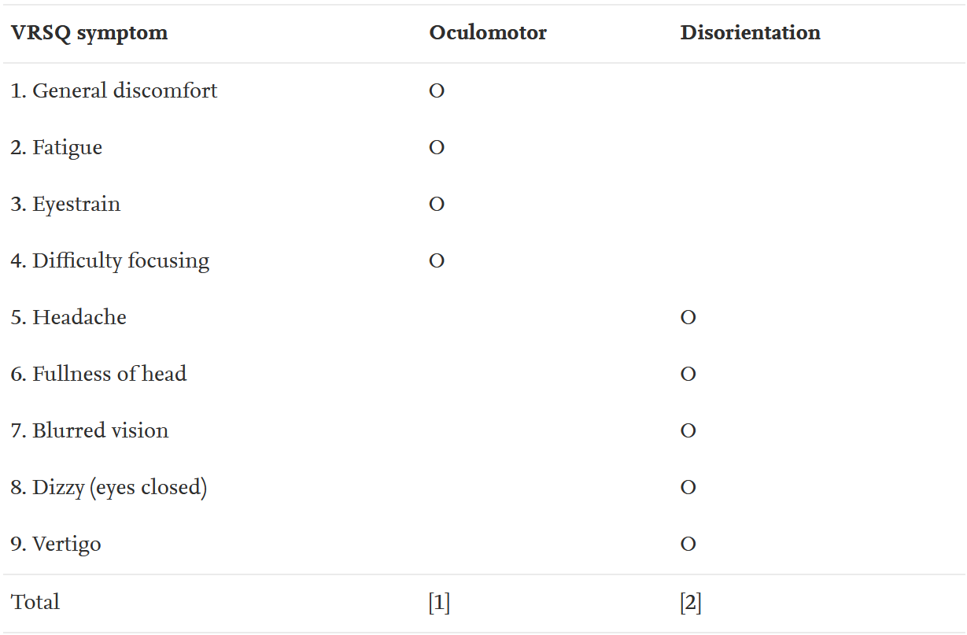
SSQ vs. VRSQ

Slide 5
Next Week
Mid-term presentation
Implementation of Tracking for VIVE Tracker
Further looking in to Data Analysis and Visualization
Ask ETH peeps about auto light of in CLA A floor
Partition Walls, How do they look? -> Decided where to do user study

